Slide 1

Storytime with AAC
Presented by: Claire Seefried
claire.seefried@elsforautism.org
Notes:
Claire Seefried
Claire.Seefried@elsforautism.org
In this PowerPoint you will find resources pertaining to our Storytime with AAC!
This includes:
Importance of core language
A letter sound correspondence activity
Review of core vocabulary words as highlighted in story
These words can be printed and used across various activities (e.g., story readings, extension activities, etc.)
Extension activities
Additional resources pertaining to core vocabulary, AAC use during school closures, and additional at home activities

Slide 2

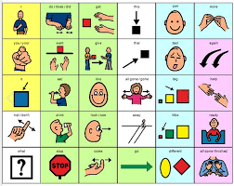
The Importance of Core Language
SUBHEAD GOES HERE
Core words make up approximately 80% of our vocabulary
Core words are those 500 or so words that we use frequently throughout the day
By mastering core words, children are able to say many things
For example, core words include: I, see, you, he, she, do, it, the, tell, not, etc., etc., etc.
These words are the glue that make our language cohesive and give us many opportunities to learn and practice language (Zangari & Wise, 2017)

Slide 3

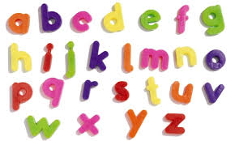
Letter-Sound Correspondence
Letter-sound correspondence refers to the sound(s) each letter(s) make
How to teach letter-sound correspondence:
  Show the letter and say its sound
  Have the child listen to this a few times
    Focus on the SOUND, not the name
  Point to the letter and say “a” as in “cat”
  Provide the child with some letters using letter cards, a letter board, an alphabet screen on a speech-generating device, or a keyboard
  Say the target sound, “a”, and have the child select the corresponding letter card (e.g., a) (Zangari & Wise, 2017)
Notes:
Review “Letter of the Week” to work on letter-sound correspondence
Letter-sound correspondence teaches children what sound or sounds each letter makes
Show the letter and say its sound
Have the child listen to this a few times (focus on the SOUND, not the name)
Point to the letter and say “a” as in “cat”
Provide child with some letters using letter cards, a letter board, an alphabet screen on a speech-generating device, or a keyboard
Say the target sound, “a”, and have the child select the corresponding letter card (e.g., a)
(Zangari & Wise, 2017)

Slide 4

Let’s review!
SUBHEAD GOES HERE

Slide 5



Slide 6


Letter of the Week
Notes:
Say the target sound (“ahh”)
Have the child select the corresponding letter card (a)
Provide support as needed so the child is successful
Allow child to practice this a few times with each letter sound
(Zangari & Wise, 2017)

Slide 7
Letter of the Week
Notes:
Say the target sound (“ahh”)
Have the child select the corresponding letter card (a)
Provide support as needed so the child is successful
Allow child to practice this a few times with each letter sound
(Zangari & Wise, 2017)

Slide 8
Letter of the Week
Notes:
Say the target sound (“ahh”)
Have the child select the corresponding letter card (a)
Provide support as needed so the child is successful
Allow child to practice this a few times with each letter sound
(Zangari & Wise, 2017)

Slide 9

Letter of the Week
Point to the letter and say “m” as in “mouse”.
https://www.youtube.com/watch?v=6QUSDu2JIY0&list=PLf_7Cxcu2jjiv9WT7lldHvw3scinv7Pci&index=5&t=0s
https://www.youtube.com/watch?v=Ezkt2Z-hZV4
Notes:
Review “Letter of the Week” to work on letter-sound correspondence
Letter-sound correspondence teaches children what sound or sounds each letter makes
Show the letter and say its sound
Have the child listen to this a few times (focus on the SOUND, not the name)
Point to the letter and say “a” as in “cat”
Provide child with some letters using letter cards, a letter board, an alphabet screen on a speech-generating device, or a keyboard
Say the target sound, “a”, and have the child select the corresponding letter card (e.g., a)
(Zangari & Wise, 2017)

Slide 10

Letter of the Week
Notes:
Say the target sound (“mmm”)
Have the child select the corresponding letter card (m)
Provide support as needed so the child is successful
Allow child to practice this a few times with each letter sound
(Zangari & Wise, 2017)

Slide 11
Letter of the Week
Notes:
Say the target sound (“mmm”)
Have the child select the corresponding letter card (m)
Provide support as needed so the child is successful
Allow child to practice this a few times with each letter sound
(Zangari & Wise, 2017)

Slide 12
Letter of the Week
Notes:
Say the target sound (“mmm”)
Have the child select the corresponding letter card (m)
Provide support as needed so the child is successful
Allow child to practice this a few times with each letter sound
(Zangari & Wise, 2017)

Slide 13
Sound blending
Sound blending assists children in learning how to blend letter sounds together in order to read and write words
  Show four pictures of familiar one-syllable words
  Label each picture
  Model the skill of blending
    Say the words slowly (stretching out the word, like b-a-a-a-a-a-a-t or m-m-m-m-m-ouse) and then point to the picture of the item and say the item (e.g. bat, mouse)
(Zangari & Wise, 2017)
Notes:
This skill should be taught once children have at least 6 letter sound correspondences
The pictures should be appropriate words based on the child’s letter-sound knowledge
The pictures should have no writing on them
Label each picture to ensure child is familiar with the item names
Repeat labeling each item by stretching out and blending the other words, have the child listen and select the picture of that word
If the child is able to stretch out or blend the sounds of words together, provide practice
(Zangari & Wise, 2017)

Slide 14

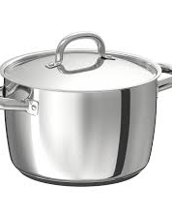


Sound Blending
Notes:
This skill should be taught once children have at least 6 letter sound correspondences
The pictures should be appropriate words based on the child’s letter-sound knowledge
The pictures should have no writing on them
Label each picture to ensure child is familiar with the item names
Repeat labeling each item by stretching out and blending the other words, have the child listen and select the picture of that word
If the child is able to stretch out or blend the sounds of words together, provide practice
(Zangari & Wise, 2017)

Slide 15



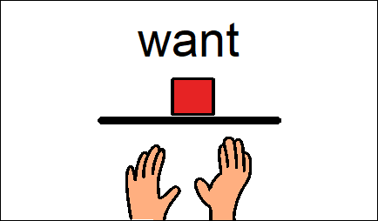


Core Vocabulary Words for Story:
Notes:
Review the core vocabulary words of the week
Engage children by having them repeat those words
-Verbally speak word
-Use AAC to express word
-Have child touch screen/word
-Say a verbal approximation of the word (e.g. “t” for “turn”, “d” for “did”)

Slide 16
Notes:
Click the sound to play the word

Slide 17
Notes:
Click Sound to Play Word

Slide 18
Notes:
Click the sound to play the word

Slide 19
Notes:
Click the sound to play the word

Slide 20
Notes:
Click to hear word

Slide 21
Core Vocabulary Words for Story:
Notes:
Click to hear word

Slide 22
Core Vocabulary Words for Story:
Notes:
Review the core vocabulary words of the week
Engage children by having them repeat those words
-Verbally speak word
-Use AAC to express word
-Have child touch screen/word
-Say a verbal approximation of the word (e.g. “t” for “turn”, “d” for “did”)

Slide 23
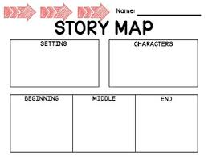
Extension Activities
Review WHO was in the story
Review WHAT happened in the story
Review WHERE the story takes place
Incorporate physical activity and movement (see additional resources slide)
Music
  Listen to music incorporating core vocabulary words (see additional resources slide)
Dramatic play
  Design pretend play activities around the concepts in the story while continuing to highlight core words throughout the story (e.g., play “school”, etc.)
Art
  Design art activities around concepts in the story
  (Zangari & Wise, 2017)
Notes:
Ways to facilitate language comprehension (e.g., review WH questions – who, what, where, when, why, etc.)
(Zangari & Wise, 2017)

Slide 24
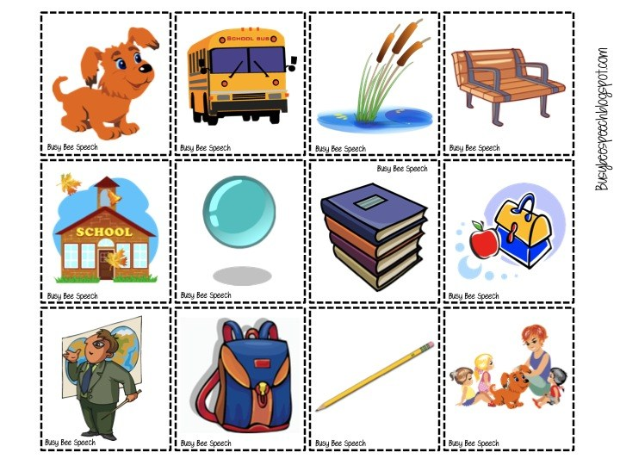
Notes:
Busybeespeech.com

Slide 25
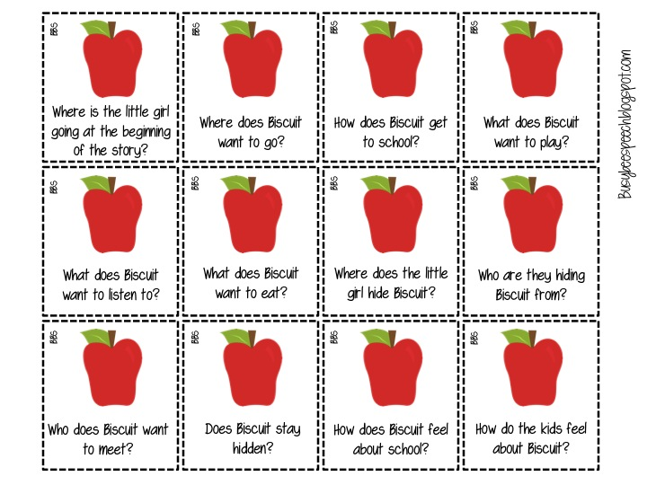
Notes:
Busybeespeech.com
Where does our story take place?
What color is the bus?
How many dogs are in our story?
What is a teacher?

Slide 26

Additional Resources
Biscuit Goes to School book:
  https://www.amazon.com/Biscuit-Goes-School-First-Read/dp/0064436160
Biscuit Goes to School read aloud story:
  https://www.youtube.com/watch?v=CdsQlnqms9A&t=49s
  https://www.youtube.com/watch?v=Sn7hd4zbRhc
  https://www.youtube.com/watch?v=Hd08q36_yOs
Biscuit Goes to School activities:
  https://busybeespeech.com/biscuit-goes-to-school/
  Prepositions: https://i1.wp.com/busybeespeech.com/wp-content/uploads/2013/08/Slide5.jpg?ssl=1
  Memory game: https://www.rif.org/literacy-central/word-match/biscuit-goes-school-memory-match
  Wordlist: https://www.rif.org/sites/default/files/Support_Materials/BiscuitGoestoSchool.pdf
  https://www.rif.org/literacy-central/book/biscuit-goes-school
  Coloring: https://coloringhome.com/biscuit-the-dog-coloring-pages
More activities:
  Yoga for Kids with Animals: https://www.youtube.com/watch?v=5XCQfYsFa3Q
  Wheels on the bus: https://www.youtube.com/watch?v=e_04ZrNroTo
  I have a pet song: https://www.youtube.com/watch?v=pWepfJ-8XU0
  BINGO song: https://www.youtube.com/watch?v=2E0hHjSwdW4
Notes:
With YouTube read aloud stories - feel free to pause video and have child comment on pictures, show core vocabulary words, etc.

Slide 27

Additional Resources
Online support for families during school closures
  https://praacticalaac.org/praactical/praactical-resources-online-aac-support-for-families-during-school-closures/
  https://drive.google.com/file/d/1a4Ct_2vJe4fjHBi5qzfKqSkOtrTicjOH/view
  https://howtoaba.com/resources-for-children-with-autism-during-covid-19/
  https://www.teacherspayteachers.com/FreeDownload/COVID-19-Superheroes-Social-Story-Coronavirus-Read-Color-Learn-5358532 Social Story regarding COVID-19
AAC resources for dealing with the COVID-19 pandemic
  https://praacticalaac.org/praactical/praactical-resources-dealing-with-the-covid-19-pandemic/
Additional read aloud stories featuring celebrities ☺
  https://www.youtube.com/channel/UCnBdzaRy-Ky9Vh54XJlFz1Q
  https://www.instagram.com/savewithstories/
High frequency words
  https://www.readinga-z.com/high-frequency-words/
  https://aaclanguagelab.com/materials/100highfrequencycorewords21.pdf

Slide 28

Additional Resources
https://www.readinga-z.com/
https://www.freckle.com/
https://jr.brainpop.com/
https://www.abcya.com/
https://www.starfall.com/h/

Slide 29

Questions?
Please feel free to contact me at: claire.seefried@elsforautism.org

